Slide 1

UNION
The UNION operator is used to combine the result sets of 2 or more SELECT statements. It removes duplicate rows between the various SELECT statements. Each SELECT statement within the UNION operator must have the same number of fields in the result sets with similar data types.
Infoway Technologies, 3rd Floor Commerce Centre, Rambaug Colony, Paud Road Pune 411038

Slide 2
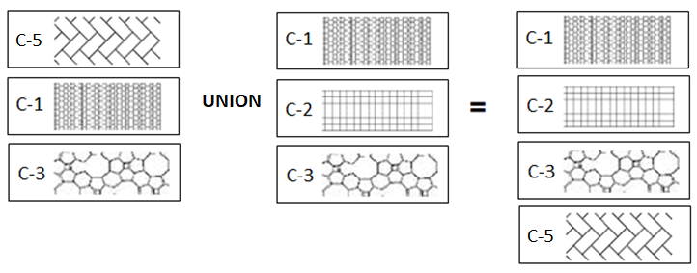
Union
To combine result set of two or more queries using the UNION operator, these are the basic rules that you must follow:
First, the number and the orders of columns that appear in all SELECT statements must be the same.
Second, the data types of columns must be the same or compatible.
By default, the UNION operator removes duplicate rows even if you don’t specify the DISTINCT operator explicitly
For example, the table ‘A’ has C-5, C-1, and C-3 and the table ‘B’ has C-1, C-2, and C-3.
Infoway Technologies, 3rd Floor Commerce Centre, Rambaug Colony, Paud Road Pune 411038

Slide 3
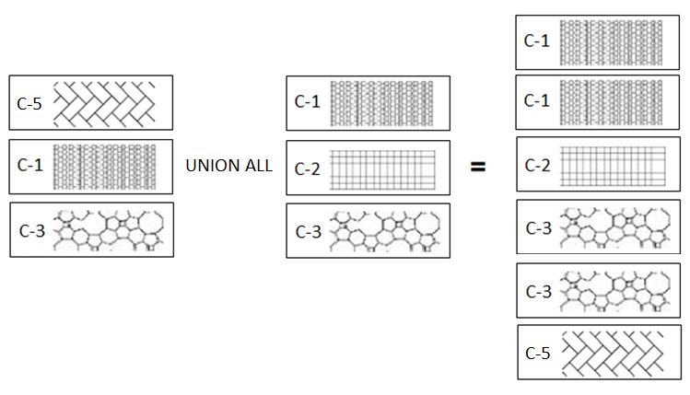
Union All
The Union ALL operator combines the results of two or more queries into a single result set that includes all the rows that belong to all queries in the Union. In simple terms, it combines the two or more row sets and keeps duplicates.
For example, the table ‘A’ has C-5, C-1, and C-3 and the table ‘B’ has C-1, C-2, and C-3.
Infoway Technologies, 3rd Floor Commerce Centre, Rambaug Colony, Paud Road Pune 411038

